Slide 1
8th grade graduation
Class of 2021

Slide 2
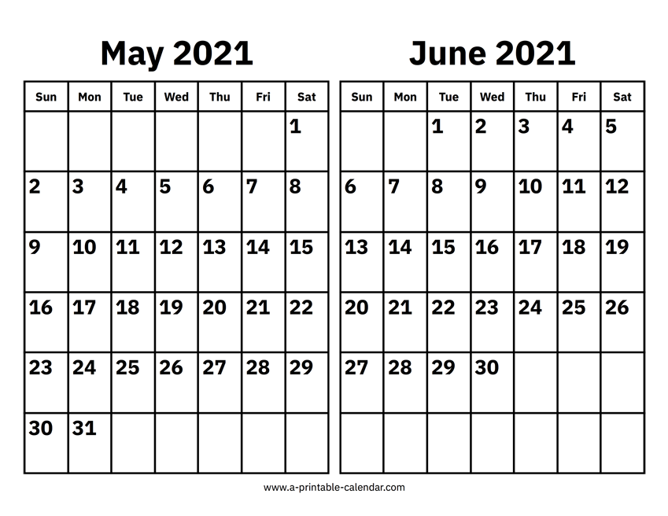
Graduation is June 7th

Slide 3
Where are you going for high school?
Load Nearpod

Slide 4
WHAT IS THE NAME OF THIS SONG?
Notes:
What song is this?

Slide 6
When do you need music during a graduation ceremony?
During the grads walk up the aisle (Pomp and Circumstance)
Walking out
Dance?
If you’re singing
Eating Food after the ceremony
Before the ceremony – when people are taking their seats

Slide 7
What makes a good graduation song?
Meaning & Message
Lyrics
Music
Sentimental
"Now they always say congratulations / Worked so hard, forgot how to vacation / They ain't never had the dedication / People hatin', say we changed and look we made it"
Notes:
https://www.seventeen.com/celebrity/music/a16001/graduation-songs/

Slide 8
Curating a playlist
Students will select and submit song(s) that should play before and after graduation.
Songs should be school appropriate (which means more than just ‘clean version’)
THINK! Why are you picking this song?
What is the mood? What is the message? What are the words about?
Submit song to list, and students will vote to see which songs are included.
Playlist is 1 hour long.
Playlist will be shared on Spotify.

Slide 9
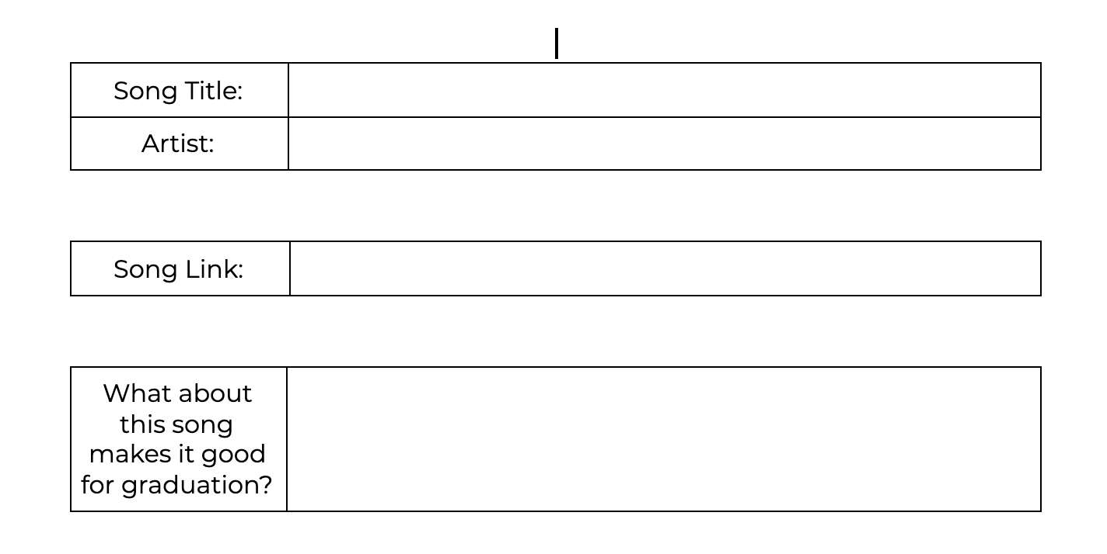
Your assignment

Slide 10
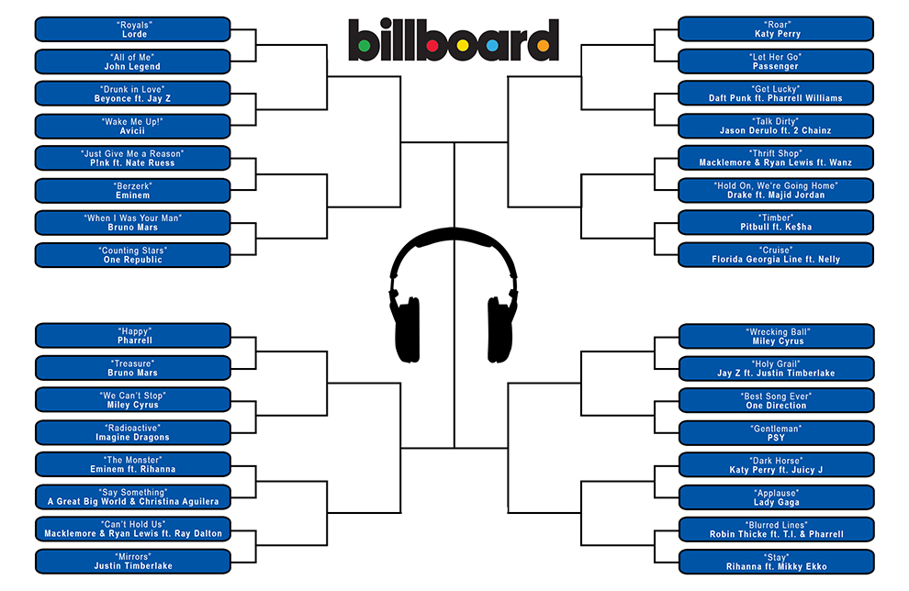
Notes:
https://officepoolstop.com/Brackets.aspx

Slide 11
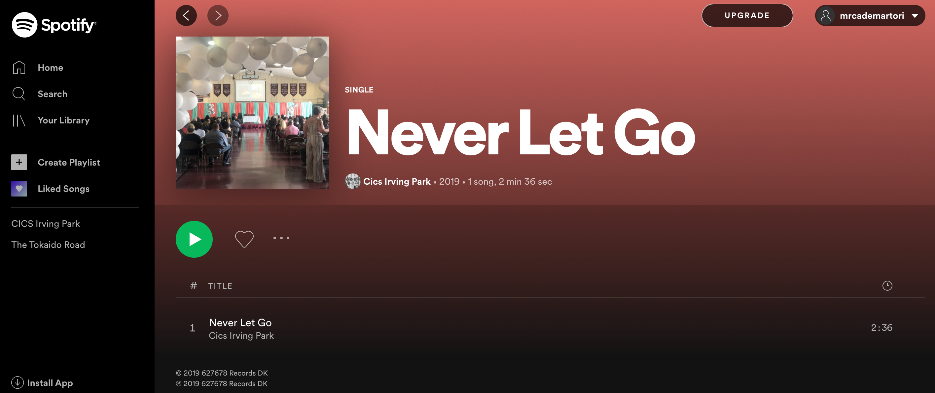
Choosing a Class Song
Typically a class song is a single song that represents your class
It can be sung as a class choir or
be performed by a few students.
What song should
represent your class?
Notes:
https://open.spotify.com/album/5huHlalBGGWLA51h53Szd7

Slide 12
Choosing a Class Song
Keep in mind:
School appropriate
Meaningful
Not too long (less than 5 mins)
Janessa would love to sing
Good for a solo / female singer
Notes:
https://open.spotify.com/album/5huHlalBGGWLA51h53Szd7

