Slide 1
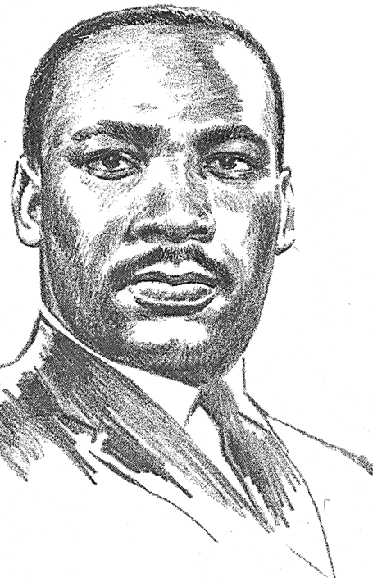
Dr. Martin Luther King Jr.

Slide 2
Kid President

Slide 3
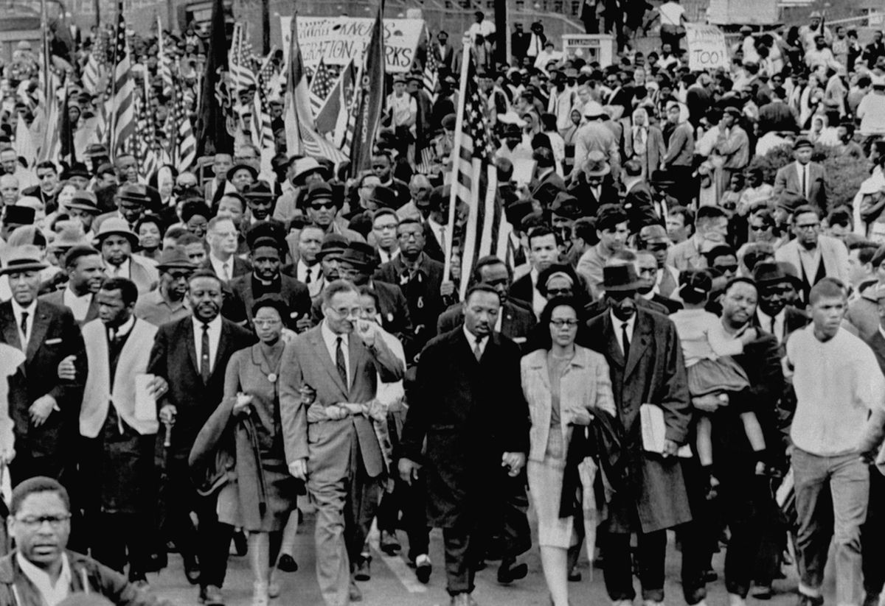
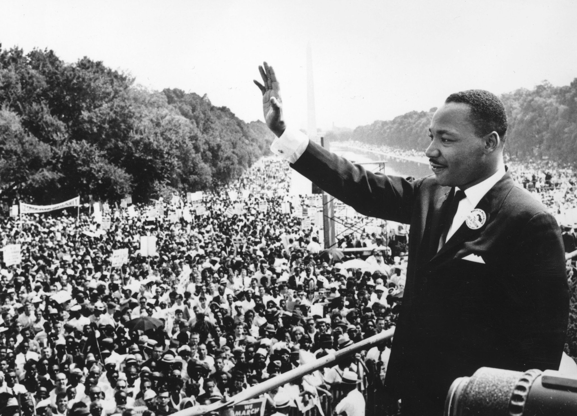
Who was he?
Dr. Martin Luther King Jr. spoke and march and fought for the rights of all people.
He was instrumental in contributing to the Civil Rights Act

Slide 4
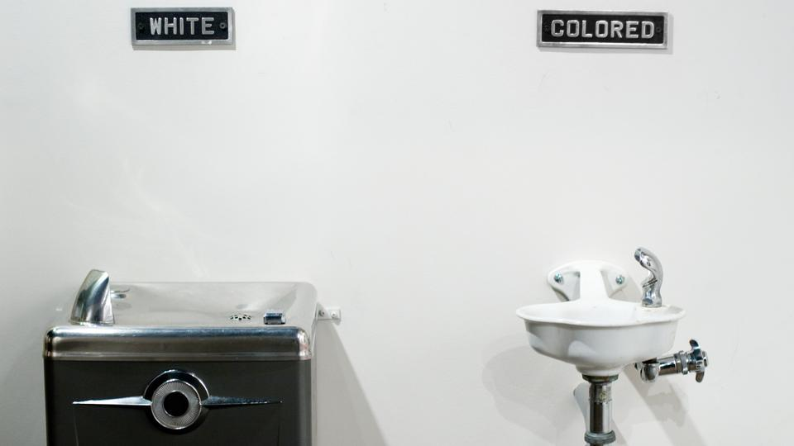
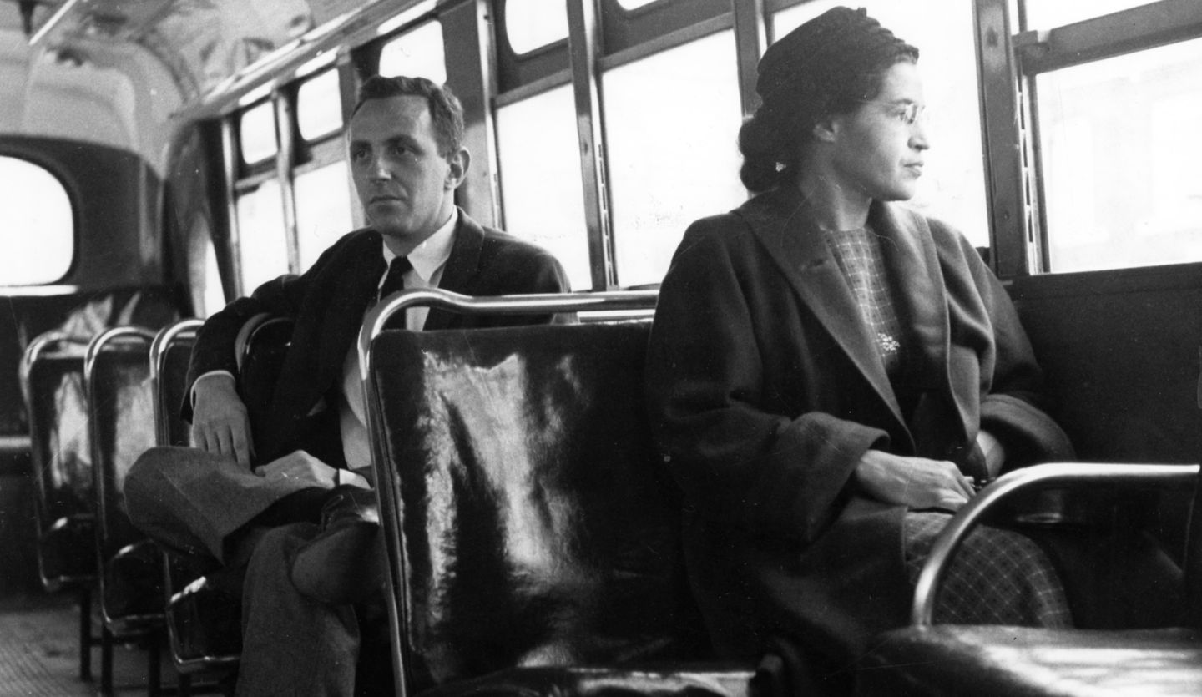
The Civil Rights Act
I’m Rosa Parks!
Before the Civil Rights Act things weren’t the same for everyone.
There were different doors people had to use, different water fountains, and different places they could sit and be.

Slide 5
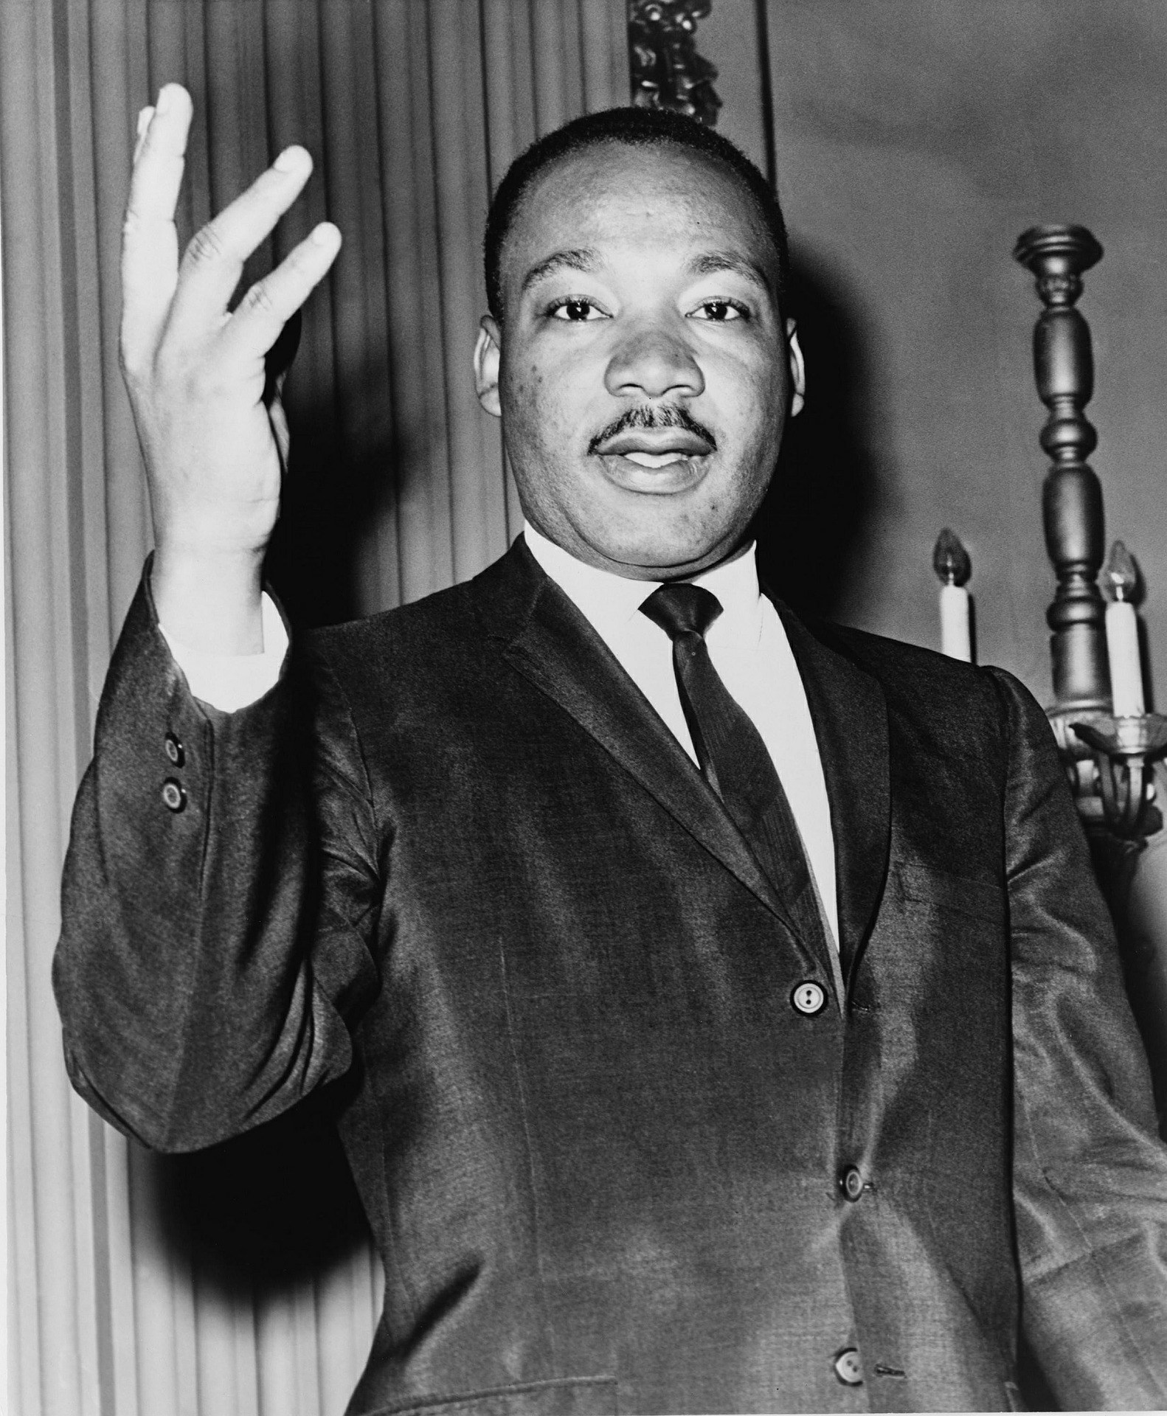
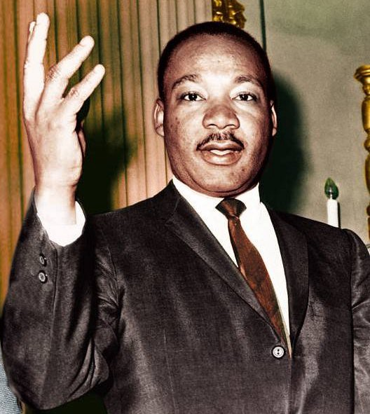
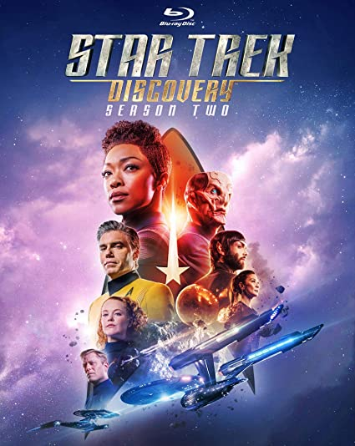
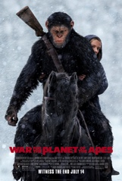
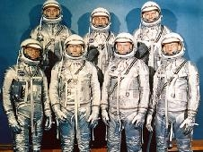
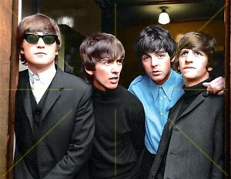
1968 was Not so long ago
In 1968
Star Trek was on TV
The Planets of the Apes movie was out
NASA was going to outer space
And the Beatles were popular
You usually see black and white pictures, which make it seem like it happened a long time ago – but it wasn’t. There are color photos and even movies of Dr. MLK.
He died in in 1968 –

Slide 6
Martin’s final speech
Notes:
Stop @ :56 or let the whole vid play

Slide 7
Call & Response Echo song
Notes:
Chords: F G C F (repeat)

Slide 8
Sign Language
Notes:
Source: https://www.youtube.com/channel/UCtwYvSO5-i5UMIN1G-ie98g

Slide 9
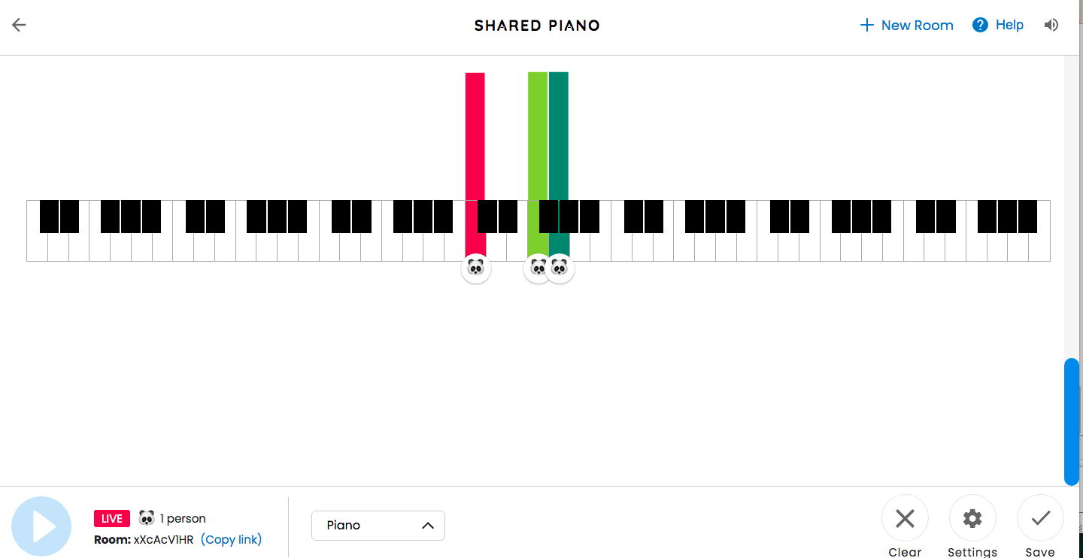
Play along + piano solo
https://musiclab.chromeexperiments.com/Shared-Piano/
Our Pattern
Notes:
https://musiclab.chromeexperiments.com/Shared-Piano/

