Slide 1
The Creative Cycle

Slide 2
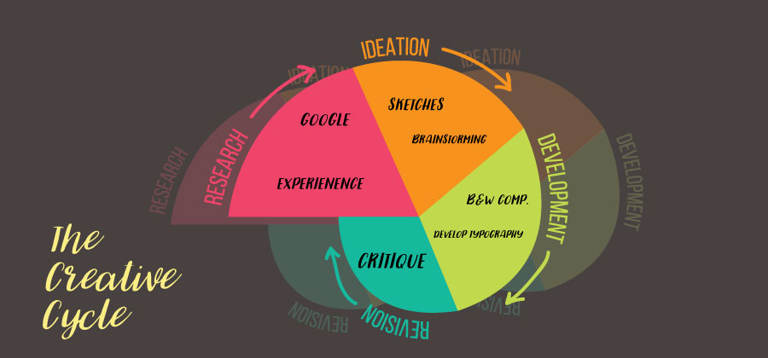
The Creative Cycle

Slide 3
In this unit...
Several Tech-based resources to create an original piece
Chrome Music Lab
Splice Beatmaker
How to use Google Classroom to push out/collect materials
Assigning Work
Rubric & other Materials
Giving Peer Feedback
Using Google Classroom to facilitate this
Paper feedback sheets
Summative Rough Draft Collected (optional)
Using Feedback to improve our product
Return physical paper copies
Final Product
Formative Assessment

Slide 4
The Standards

Slide 5
Tools
Chrome Music Lab (Elementary)
https://musiclab.chromeexperiments.com/Song-Maker
Splice Beat Maker (Middle School)
https://splice.com/sounds/beatmaker

Slide 6
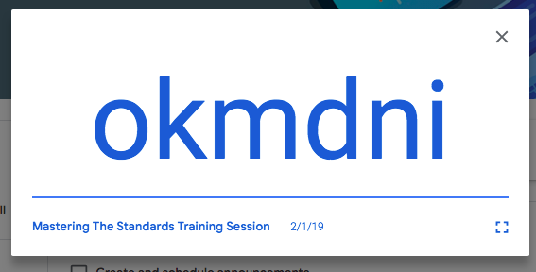
Google Classroom
https://classroom.google.com

Slide 7
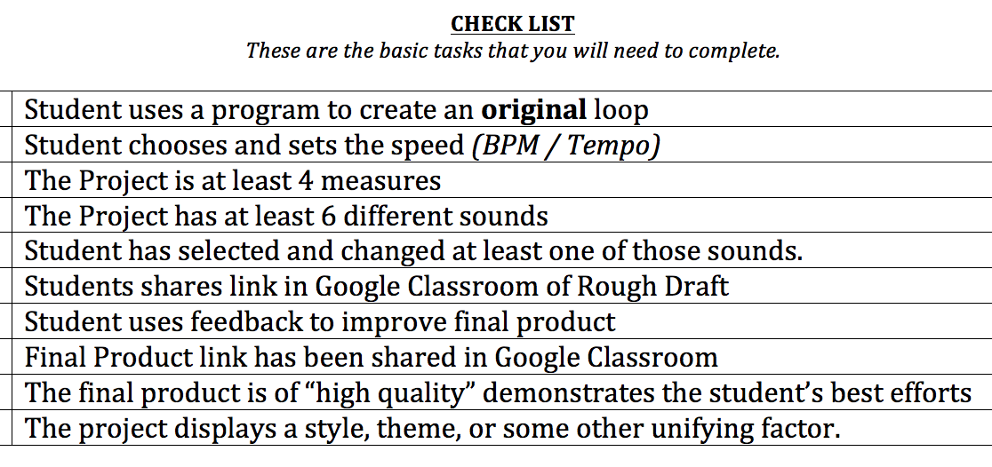
Rubric Checklist

Slide 8
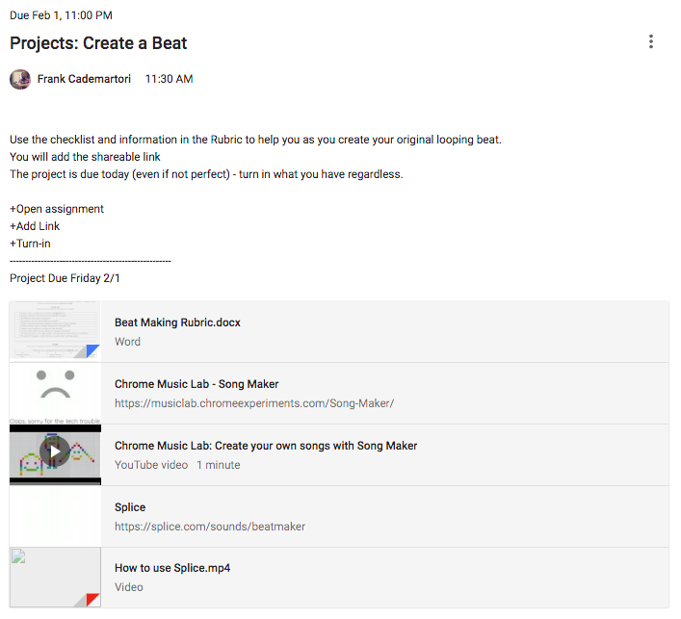
Google
Classroom
Notes:
https://www.youtube.com/watch?v=kxGWsHYITAw&t=5s

Slide 9
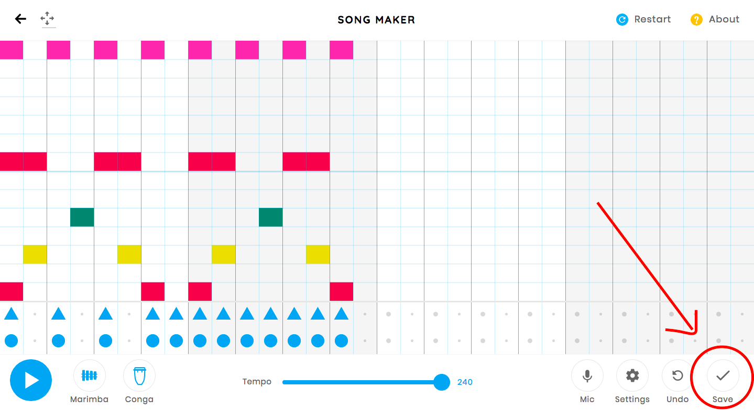
Turning it in

Slide 10
Turning It in
tinyurl.com/music2119

Slide 11
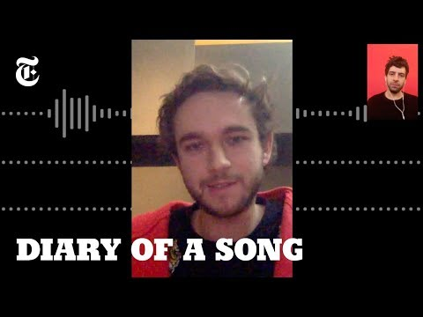

Slide 12
The Making of a Song
What did you learn? What were you surprised by?
Do you think is weird or are most hit songs made this way?
Did Maren Morris & Zedd making the song by themselves?
Why did so many people work on the song?
Is the version you hear on the radio the FIRST version?
Why was feedback so important to the process?

Slide 13
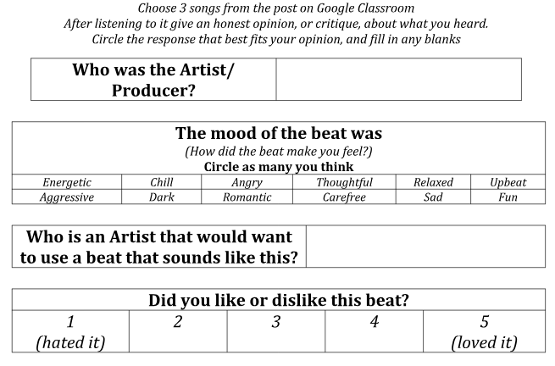
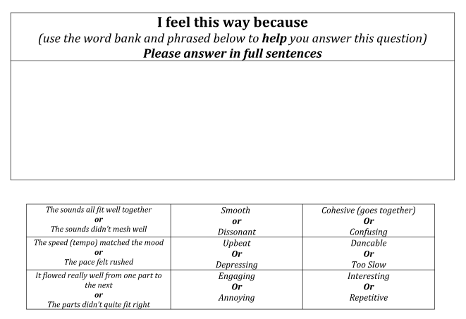
Peer Feedback

Slide 14
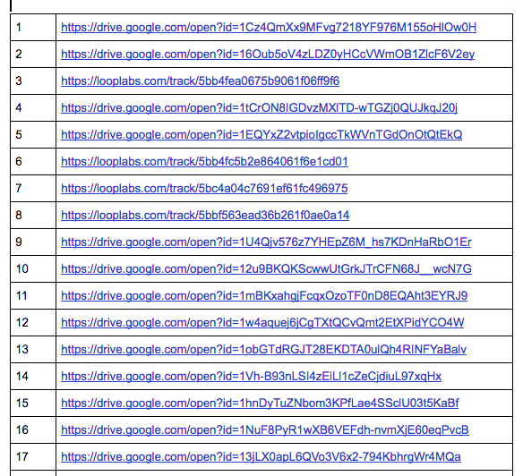
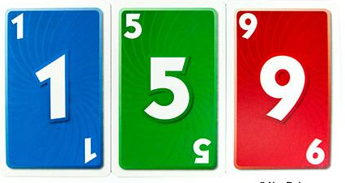
How to Facilitate
Compile all Rough Drafts in Anonymous numbered doc
Students choose 3 different colors of numbered note cards
Listen to those songs
Prevents everyone from listening to song #1, can assign more or less if needed.

Slide 15
tinyurl.com/roughdrafts

Slide 16
Extra Resources

Slide 17
Final Product Due
This is your FINAL product
This is the one I will be using to grade
Double Check the Rubric before you submit
Did you check all the boxes?
Should be “Radio Ready”
Are you comfortable with your song being heard?
Is this your best work?

Slide 18
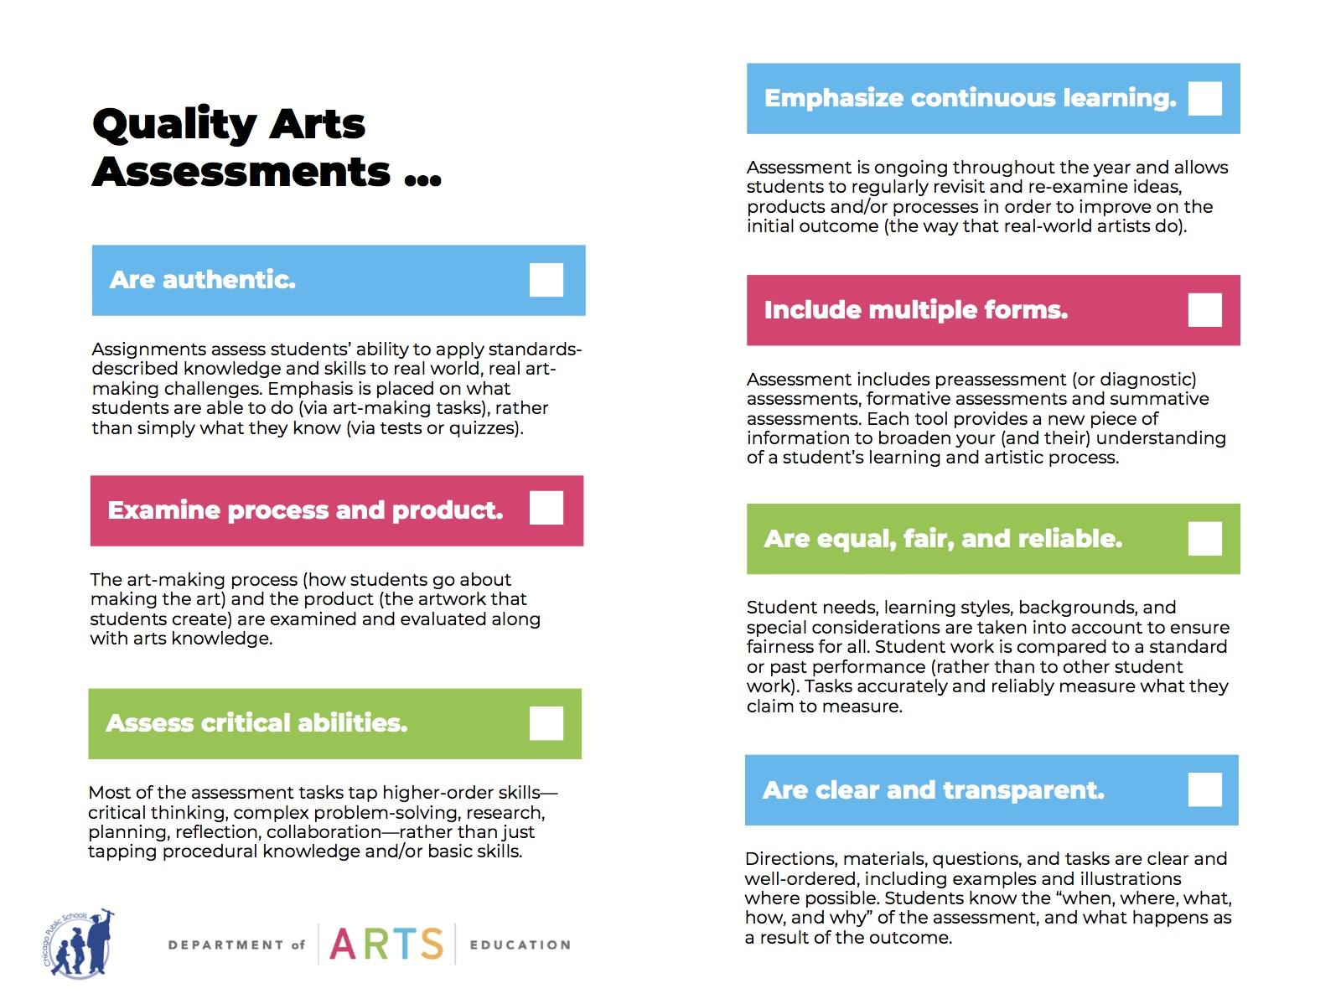
Notes:
Evaluate Assessment

Slide 19
Brainstorming
Is there an ideal assessment?
Do you have to hit all 7?
What are your goals for the lesson? What do need to assess?
How might this be modified to suit your needs?
How to use with younger grades?
How could you do this without using tech?

Slide 20
Return @ 12:30

Slide 21
Teaching For Mastery

Slide 22
Discussion Quotes
“As a high school student I was frustrated in some subjects (maths being one) as I lost track of what was happening in class and could not follow the teacher. I was not motivated enough and did not have the social skills to close that gap. As a result, I ended up wasting a lot of class time without learning anything. This is a gigantic waste of time and money for our society.”
“The problem I think is that many students are not enthusiastic about learning in any shape or form. Many students, I fear, do not have the self-discipline and motivation to master Mastery Learning. I may be wrong though, maybe they are just slack and unmotivated because of the current passive education system.”

Slide 23
What is the function of Assessment?
Is assessment beneficial?
Who is it benefitting?
Why are you assessing?
Is it worth your class time?

Slide 24
What is Assessment?
Assessment
Vs.
assessment

Slide 25
Assessment Workshops
Instrument Self-Recording (5th & up)
Students Self Record Weekly
Turn in video to Google Classroom
Individual Assessment & Formative Feedback
Lego Rhythms (3rd - 5th)
Use Legos to compose : Accessible to all
Makes thinking visible
Tangible artifacts
Keezy App (K - 3rd)
Easy way to self record
Apple only (sry)
Adaptable

Slide 26
tinyurl.com/AISmaterials

Slide 27
Create / Adapt Your Own!
Take what you’ve learning and seen today and modify it to suit your own needs.
Think about both what and why you’re assessing
Reference the Best Practices Checklist.

Slide 28
Contact Me
Frank Cademartori
fcademartori@yahoo.com
aSoundMind.edublogs.org
@aSoundMindEdu

