Slide 1
Charlie Brown & Christmas Jazz

Slide 2
Today We will
Identify the Genre Jazz
What is the history
Can we make our own?
Discuss the composer Vince Guaraldi
Who is he & What did he do?
Watch a short film

Slide 3
The History of Jazz

Slide 4
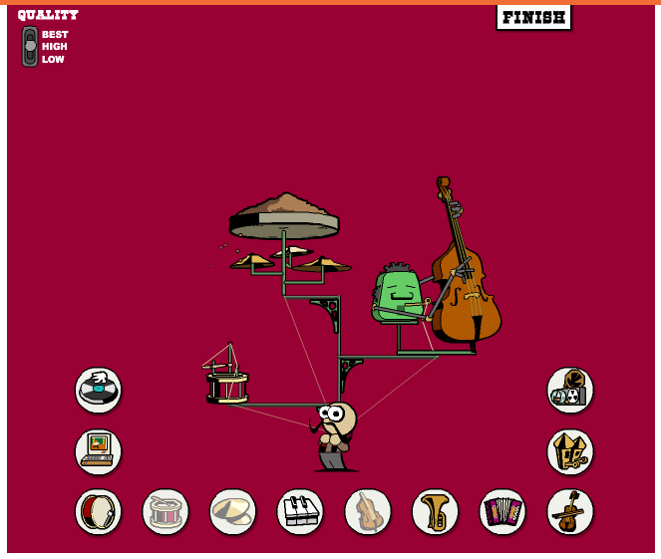
Can you make Jazz?
https://www.brainpop.com/games/onemanband/
Click me and let’s create an impromptu Jazz song as a class
Can you make your own?
Can you make your own?
Additional Resources: (Independent/Center work)
Jazz Videos: http://pbskids.org/chuck/video_jazz.html
Jazz Games: http://pbskids.org/chuck/index.html#/jazz

Slide 5
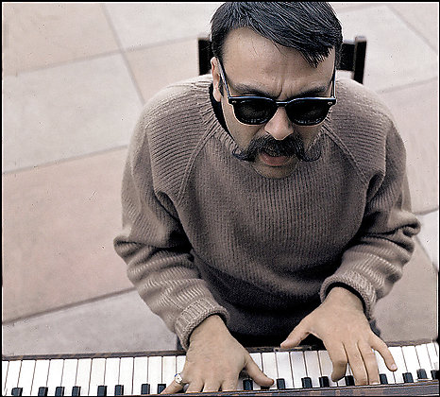
Vince Guaraldi
American Jazz Composer
Born 1928, in San Fransisco
One of the most influential and recognizable sounds in Modern Jazz

Slide 6
Award Winner
In 1962 he won a Grammy for “Best Original Jazz Composition”

Slide 7
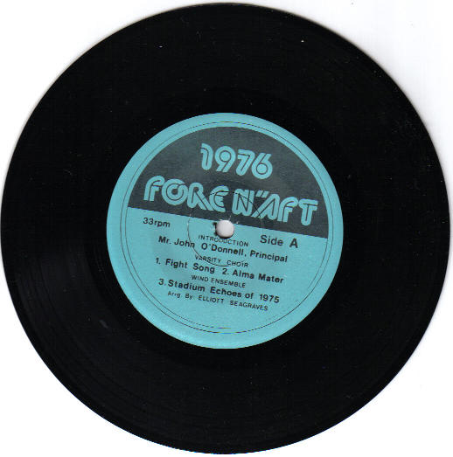
What is a “B-side?
In a surprising twist, he won the Grammy for one of his B-sides

Slide 8
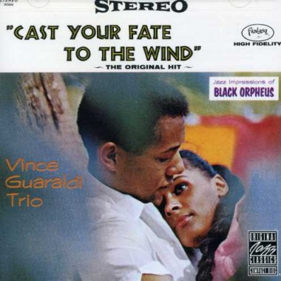
The song was called…
Cast Your Fate to the Wind

Slide 9
The story goes…
Story has it that Lee Mendelson (the producer of an upcoming TV series) heard the song on the radio in a taxi while driving across the Golden Gate Bridge. He was so moved by the piece he had his taxi pull over and tracked down the composer immediately!
He offered him a job on the spot to write all the music for an entire TV special.

Slide 10
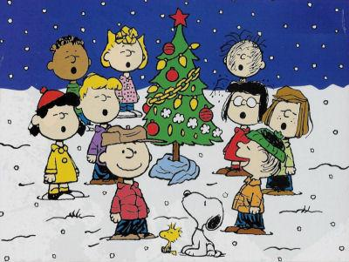
The TV Special was “Peanuts”
2 Weeks later he wrote and submitted the song “Linus and Lucy” the most iconic song of the series

Slide 11
Linus & Lucy

Slide 12
Let’s watch (& listen)
Load .mp4

